Slide 1

Section 2. Practical tips for writing your applied paper:
Writing the first half of your paper

Slide 2



Writing the first half of your applied paper
The Introduction
Perhaps the most important part of your paper.
Why should someone keep reading your paper if they aren’t “hooked” by the end of the introduction?

Slide 3

The Introduction
When I went to write my first introduction, I felt overwhelmed.
I surrounded myself by well-published and well-written papers…
I learned there is a method to (and template for) writing a good introduction.
Don’t reinvent the wheel
Read some classics
Let’s break it down…

Slide 4
The Introduction
An (applied micro) introduction should contain:
(i) General motivation. Captivate economists and non-economists alike.
(ii) Specific motivation. Appeal to policy being evaluated or theory being tested.
(iii) Brief description of background
(iv) Data description
(v) Description of identification strategy.
(vi) Description of principal results.
(vii) Roadmap (optional)
I like to approach writing the introduction as a box-checking exercise
Let’s walk through an example…
-You are NOT writing a mystery novel!
-Reader should know exactly what to expect by the end of the introduction.

Slide 5

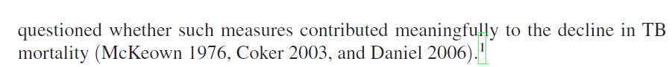
(i) General motivation
(ii) Specific motivation that appeals to scholars working in this area.
Previous explanations for the TB mortality decline
Highlight explanation we are interested in testing (i.e., public health)
Highlight that this remains an open question, which also highlights our contribution

Slide 6
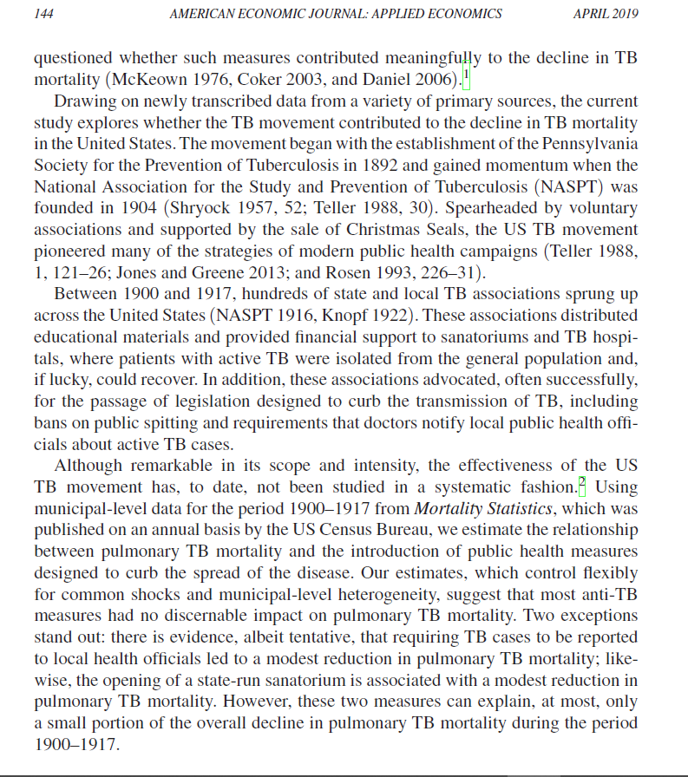
(iii) Important background details
Historical background
Relevance to modern day public health
What constituted the anti-TB campaign?
(iv) Data description
(v) Identification
(vi) Results

Slide 7
Three Common FAQs
How many contributions should I list?
A good paper probably only makes one or two real contributions.
If you must list more, clearly indicate which contribution you think is most important.
Big mistake: List too many contributions and do not rank them in order of importance
Big mistake: Claim to advance a number of different fields.
Signals you aren’t sure where your major contributions lie.
Is this a labor paper or a behavioral paper or a econ history paper…or something else? Avoid creating this confusion
Do not confuse editors in search of referees
How long should my introduction be?
No rule of thumb.
But, avoid lumping your intro and background sections together.
Error on side of brevity. Do not ask reader to wade through a 10-page introduction.
Of the last 15 full-length papers I have written for economics journals (size 12 font, double-spaced):
1-2 pages | 2-3 pages | 3-4 pages | 4-5 pages | 5+ pages
3 papers | 6 papers | 3 papers | 3 papers | 0 papers!!!

Slide 8
Three Common FAQs
How much does my writing matter?
This applies to the paper in its entirety, but it matters a lot!!!
Grammar
From my perspective, blatant grammatical, spelling, sentence structure errors, etc. are a death sentence for a paper.
Why should I trust that you were any less careless regarding the unobserved part of your research project (e.g., data collection, cleaning, and analysis)?
If I am refereeing a paper and the introduction is riddled with these types of mistakes, I generally quit reading and recommend a “strong rejection.”
Hiring a copy editor can be a great idea!
Style and tone
Be engaging without being chatty or informal.
More formal than the language you hear being used in seminars
For instance, avoid words like “get” and “got” and avoid using contractions (e.g., won’t, don’t, can’t)
Read what you wrote out load
Does each sentence set up the next?
Does each paragraph set up the next?
Again, go read some classics
Wright, Gavin. 1981. “Cheap Labor and Southern Textiles, 1880-1930.” Quarterly Journal of Economics, 96(4): 605-629.
Charles, Kerwin et al.. 2009. “Conspicuous Consumption and Race.” Quarterly Journal of Economics, 124(2): 425-467.

Slide 9
Short break

Slide 10
Background
Break into subsections (not necessarily in this order):
(i) Background details regarding your right-hand side variable of interest
Include information relevant to your identification strategy
How many policy changes do you observe?
For how many units (e.g., cities, counties, states, etc.) do you observe pre- and post-treatment data?
(ii) Background on your relationship of interest
(iii) Background specific to the theory being tested (if any)
(iv) Lit review can be a separate section or woven into the above.
I prefer this approach.
Flows better
But, harder to pull off
Include subsection headers within background.
Very helpful for reader

Slide 11
Example 1. “The Effects of Pretrial Detention on Conviction, Future Crime, and Employment: Evidence from Randomly Assigned Judges” (Dobbie et al. 2018, American Economic Review)
Goal of paper: Use detention tendencies of quasi-randomly assigned bail judges to estimate the causal effects of pretrial detention on subsequent defendant outcomes.
Background, Section A. Overview of the bail system in the United States
General overview on how bail system works
Background, Section B. Description of setting specific to their data (i.e., Philadelphia and Miami-Dade Counties)
Broken into 3 subsections:
(i) Philadelphia County bail system
(ii) Miami-Dade County bail system
(iii) Describe how the features of these bail systems make them an ideal setting for their research design.
Subsection B. (iii) is a great example of how one can describe the intuition behind the identification strategy before regression equations.

Slide 12
Example 2. “Personal Belief Exemptions for School-Entry Vaccinations, Vaccination Rates, and Academic Achievement” (Hair et al. 2018, Journal of Health Economics)
Goal of paper: Examine how state-level nonmedical exemptions from school-entry vaccine mandates affect vaccination rates in early childhood and academic achievement in middle school.
Straightforward (and well-written) paper that does not require a lengthy background section.
Background, Section 1. Description of policy changes in treated states (i.e., AR and TX).
Background, Section 2. Discussion of how exemptions might affect a downstream outcomes.
Description of possible mechanisms.
Great discussion on mechanisms before results are even presented.

Slide 13
Example 3. “Safeguarding Consumers Through Minimum Quality Standards: Milk Inspections and Urban Mortality, 1880-1910” (Anderson et al. 2022, NBER Working Paper No. 30063)
Goal of paper: Estimate the effect of municipal-level milk inspections on infant and waterborne mortality.
Background, Section 1. General history of municipal milk inspections in the United States.
Describe exactly how inspections worked.
Background, Section 2. History of other efforts to provide pure milk.
Give readers a sense of what other public health policies and efforts were being mandated.
Relevant for the empirical strategy. Telling reader what they should be worried about!
Background, Section 3. Literature review on minimum quality standards (MQSs).
Review the competing empirical literature and describe the theoretical contributions
Of the 3 examples, this paper tests a classic economic theory, whereas the others do not. The literature review must tackle both empirical and theoretical studies.

Slide 14
Background: A common mistake!
In one’s literature review, not all previous studies should be treated equally.
Researchers should provide careful and accurate evaluations of previous studies.
Most policymakers have never heard of fixed effects, have no idea what a regression discontinuity is, and do not care whether state-specific time trends were included on the right-hand side.
Policymakers and non-economists count on us to communicate which studies should be taken seriously and which should not (or be ignored).
For instance, giving studies that rely on cross-sectional policy variation the same weight as those that rely on within-state policy variation comes with the risk of leading policymakers astray.
For example, researchers interested in the relationship between marijuana use and alcohol consumption all too often declare that the literature is “mixed”, citing Pacula (1998a) and Williams et al. (2004) as evidence of complementarity and Kelly and Resul (2014) and Sabia et al. (2017) as evidence of substitutability.
This is a LAZY characterization of the literature.
Pacula (1998a) and Williams et al. (2004) relied on cross-sectional policy variation. Their estimates could simply reflect unobserved factors at the state level such as preferences and attitudes.
On the other hand, Kelly and Resul (2014) and Sabia et al. (2017) used panel data and exploited well-defined natural experiments…much more credible research design!

Slide 15
Data and empirical strategy
Two separate sections or just one?
Both ways common
I prefer combining into one section.
Empirical strategy section before data section?
I’m not a huge fan
I want to understand the data before thinking about the empirical strategy in detail
All in one section, I prefer:
First, begin by describing your outcome data.
Second, describe your primary estimating equation.
Lastly, describe the data for your right-hand side variables.
Let’s go back to the milk inspections paper (Anderson et al. 2022)…

Slide 16
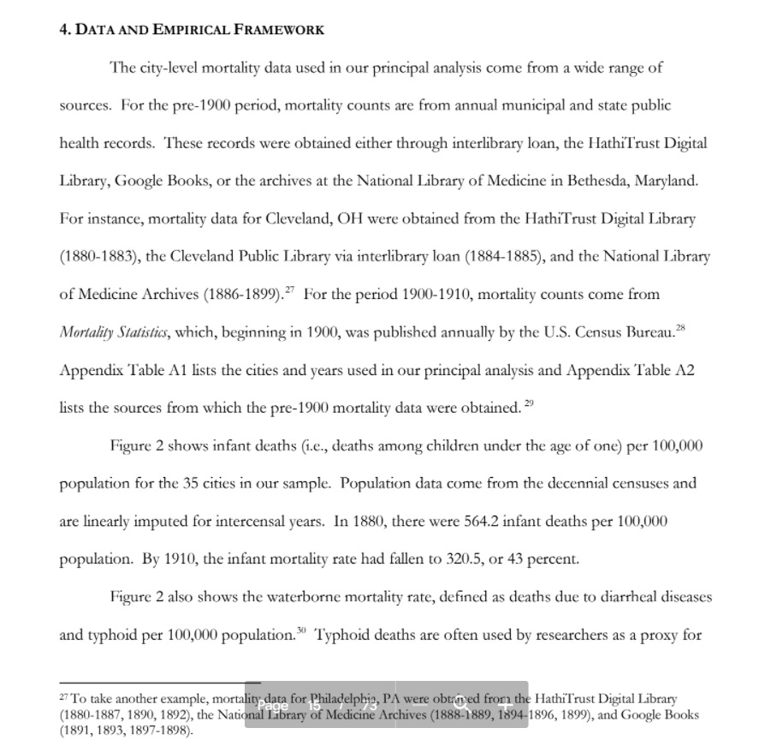
First, we describe the data sources for outcomes of interest (i.e., mortality rates).
If possible, emphasize data collection efforts!
Shed light on where identification is coming from. It should never be a black box (App. Table A1).
List your sources in detail. Roadmap for replication (App. Table A2).
Show descriptive figures, such as trends in your outcomes (Figure 2)
Spices things up a bit.
Avoid a long boring data description
Highlight interesting trends
Highlight differences in means between groups
Etc.

Slide 17
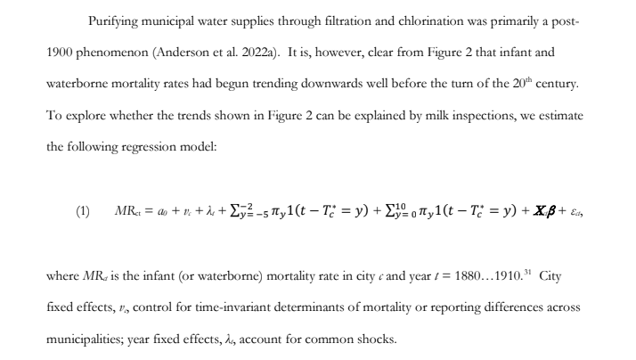
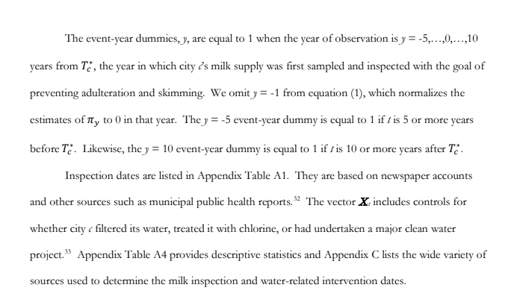
Next, describe estimating equation.
Use descriptive figures/statistics as motivation for your regression equation.
Don’t screw up your subscripts!!!
Finally, use your regression equation as a jumping off point to discuss right-hand side variables
First, describe primary right-hand side variable of interest.
After that, discuss the other Xs.
I like to list their sources and other pertinent information in footnotes.
Sometimes, Xs are not that important. Presenting them in this manner allows the reader to “choose their own adventure.”
If you want the details, read footnote.
If not, skip it.
Common to see long descriptions of the Xs in a data section before empirical strategy.
I do not recommend this.
Putting this info in main text can disrupt flow of the manuscript

Slide 18
Short break

Slide 19
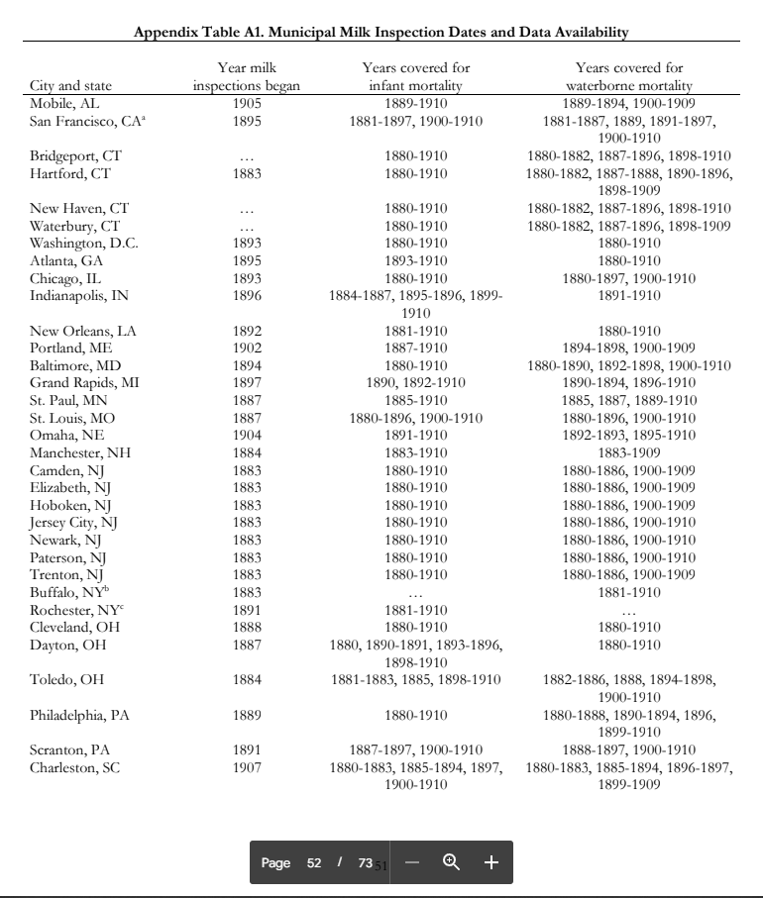
back

Slide 20
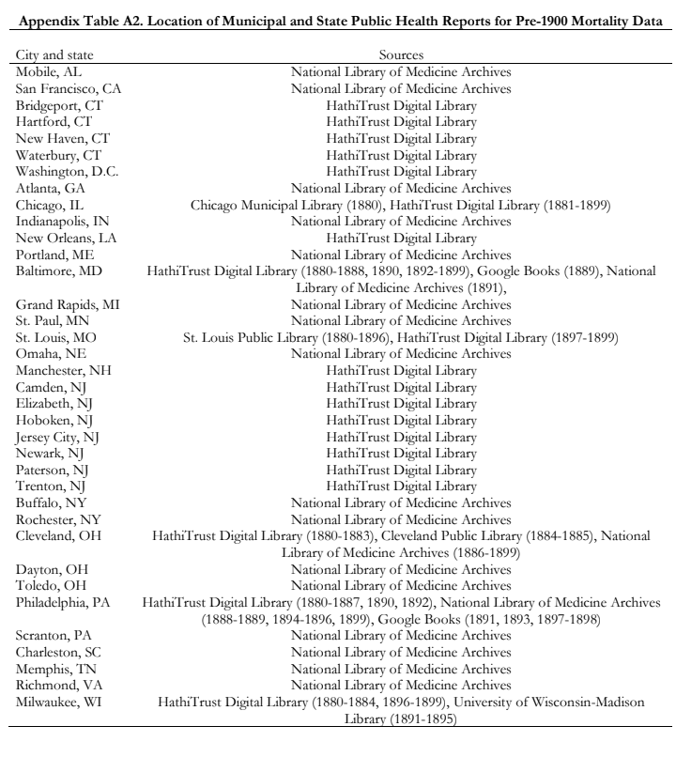
back

Slide 21
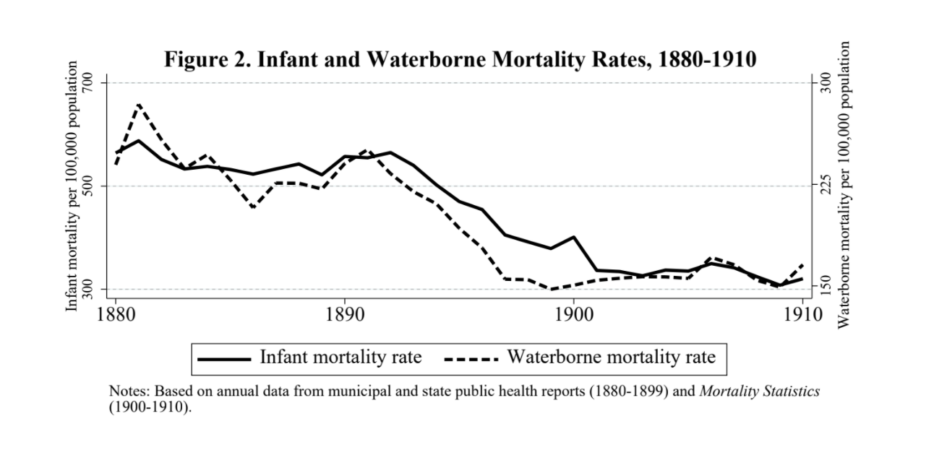
back

Slide 22
Section 2. Practical tips for writing your applied paper:
Be careful when collecting and cleaning your data (a cautionary tale!)

Slide 23
Collecting and cleaning data sets
The data collection and cleaning process is where the empirical component of your project begins.
It is also one of the most important.
It does not matter if you are using the newest and fanciest estimator, when you are using it on a data set filled with systematic errors.
This could happen in the data collection phase.
Or in the data cleaning phase
You don’t want to publish a paper, have it cited 1,500 times, and find out 15 years later that your estimates were a product of data transcription or coding errors…

Slide 24
Re-examining the Contribution of Public Health Efforts to the Decline in Urban Mortality D. Mark Anderson Kerwin Charles Daniel Rees
AEJ: Applied (2022) 14: 126-157
Using data on 25 major American cities for the years 1900-1940, we revisited the causes of the urban mortality decline at the turn of the 20th century
Following previous researchers, we explored the extent to which filtering and chlorinating water supplies contributed to the decline in urban mortality
In addition, we explored the effects of other municipal-level efforts that were, at the time, viewed as critical in the fight against food- and water-borne diseases but have not received as much attention
Clean water projects
Sewage treatment plants
Milk-related interventions

Slide 25
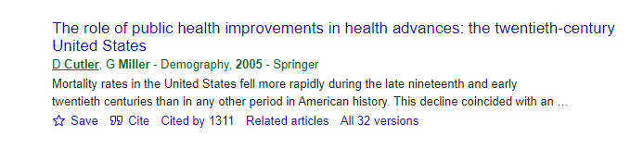
What did we find?
Most interventions did not matter
Water filtration was the exception
Water filtration is associated with a 36-41 percent decease in typhoid mortality and an 11-13 percent decrease in infant mortality. This latter estimate, however, is much smaller than those found by previous researchers, including the seminal work by Cutler and Miller (2005).
Using data from 13 major American cities for the period 1900-1936, Cutler and Miller (2005) found that filtration led to a 35% reduction in infant mortality
Why are our results so different? What was our process for reconciling our estimates with their estimates?
Using the original data provided by Cutler and Miller (2005) and their specification, we find that the estimated effect of filtration on infant mortality shrinks by two-thirds when a series of data transcription errors are corrected.

Slide 26
For infant mortality, 79 city-year observations in the C&M data set are recorded incorrectly (out of N = 415)
In 9 out of the 13 cities in their sample, C&M make systematic transcription errors for the years 1910-1917
Differences are not large for some cities (e.g., Chicago)
Differences for other cities, however, are substantial (e.g., New Orleans)
In all cases, the values recorded by C&M are less than the correct counts from Mortality Statistics
In addition to the systematic errors for the years 1910-1917, C&M make several other transcription mistakes, some of which can be easily explained.
Differences in Recorded Infant Mortality Counts between Cutler and Miller (2005) and the U.S. Census Bureau’s Mortality Statistics
City | Year | C&M’s recorded infant mortality countª | Correct infant mortality count from Mortality Statistics^{b} | Reason for difference (when known)
Chicago, IL | 1910 | 6595.52 | 6844
 | 1911 | 6017.86 | 6252
 | 1912 | 6394.31 | 6678
 | 1913 | 6649.87 | 6939
 | 1914 | 6571.52 | 6878
 | 1915 | 5942.99 | 6219
 | 1916 | 6566.35 | 6910
 | 1917 | 6246.72 | 6664
 | 1931 | 766 | 2992 | To calculate, one needs to add white infant mortality (=2,617) and nonwhite infant mortality (=375). It appears as if C&M incorrectly added mortality for one-year-olds, rather than infants, for whites (=391) and nonwhite infant mortality, which gives their recorded total of 766.
Cleveland, OH | 1924 | 2366 | 1386 | To calculate, one needs to add white infant mortality (=1,219) and nonwhite infant mortality (=167). It appears as if C&M incorrectly added overall nonwhite mortality (=1,147) and white infant mortality (=1,219), which gives their recorded total of 2,366.
New Orleans, LA | 1910 | 571.931 | 1061
 | 1911 | 595.471 | 1071
 | 1912 | 416.903 | 774
 | 1913 | 500.74 | 934
 | 1914 | 477.419 | 883
 | 1915 | 492.79 | 927
 | 1916 | 404.008 | 757
 | 1917 | 446.364 | 866
Pittsburgh, PA | 1901 | 6578 | 1580 | C&M incorrectly recorded the overall mortality count instead of the infant mortality count.
 | 1904 | 771 | 1771 | C&M incorrectly entered “1771” as “771”

Slide 27
Comparing our Infant Mortality Estimates to those of Cutler and Miller (2005)
 | (1) Replicating C&M | (2) Column (1) + cluster SEs | (3) Column (2) + correct mortality counts | (4) Column (3) + correct dates | (5) Our specification limited to C&M’s city-years
Filtration | -.429*** (.090) | -.429*** (.138) | -.125* (.068) | -.067 (.057) | -.100** (.045)
N | 415 | 415 | 410 | 410 | 415
Years | 1905-1936 | 1905-1936 | 1905-1936 | 1905-1936 | 1905-1936
Notes: The dependent variable is equal to the natural log of the infant mortality rate in city c and year t. Controls for the C&M regressions include those listed in Appendix Table 5, municipality fixed effects, year fixed effects and municipality-specific linear trends. Controls for our regression include those listed in Table 5, municipality fixed effects, year fixed effects and municipality-specific linear trends.

Slide 28
Section 2. Practical tips for writing your applied paper:
Producing Effective Tables
Useful Phrases When Describing Regression Results
Thinking about Statistical Significance and Magnitude
Data Mining
Sensitivity analyses and falsification tests

Slide 29
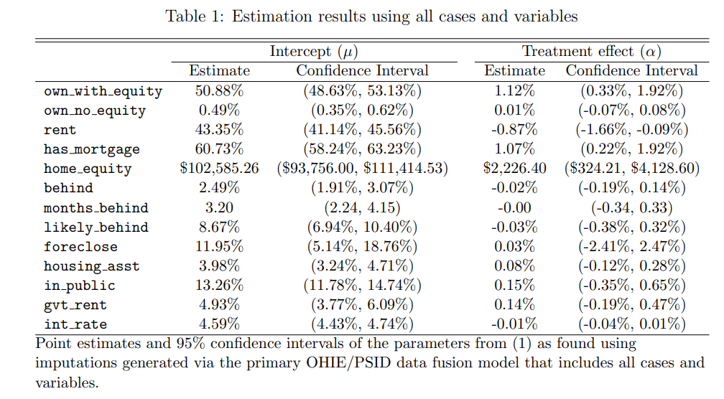
This table is from a recent submission to a top field journal. What can be improved?

Slide 30
The title could certainly be more informative.
Were these variable names copy and pasted from the Stata output!?

Slide 31
In general, the table is too cluttered. There is too much going on...
Measure in 1000s of $s.
I don’t need to know the effect down to the penny
What is the treatment? Use the notes to provide some sense of what is being estimated and how. Notes to tables should allow them to “stand alone.”

Slide 32
Period here instead of colon
Table 1. Years of schooling and hourly wages: Sample restricted to Danish respondents
 | Men Women wages ln(wages) wages ln(wages)
Schooling | 5.64 .054* (5.11) (.030) | 7.83** .094*** (3.55) (.007)
Observations | 12,385 | 12,012
Notes: The sample is restricted to CHAT respondents ages 25-45 from Colorado, Nebraska, and Iowa whose wage was greater than or equal to $3.25 per hour. Each column reports an estimate from a separate OLS regression of wages on years of schooling. Controls include race, ethnicity, marital status, union status, years of experience, tenure at current job, and firm size. Standard errors clustered at the state level are reported in parentheses. * Statistically significant at the 10% level; ** at the 5% level; *** at the 1% level.
Keep the table uncluttered. Don’t report the estimated coefficients of the controls.
Can anyone find the mistake that Dan Rees (who I will happily throw under the bus) made in this table!?
Ideally, you provide enough information in the notes to the table so that the reader can interpret the estimates without having to read the text.
Now you can use a colon here

Slide 33
Useful Phrases When Describing Regression Results
I find evidence of a negative relationship between years of schooling and earnings.
The results suggest that schooling is negatively related to earnings.
Consistent with the hypothesis that educational attainment affects earnings, I find that...
A one-year increase in schooling is associated with a 6.8 percent increase in earnings.
The estimate of β is .068, suggesting that an additional year of schooling leads to a 6.8 percent increase in earnings.
The estimated effect of an additional year of schooling on earnings is positive 6.8 percent.

Slide 34
Common Pitfalls When Describing Regression Results
Not being clear about the units
Focusing solely on statistical significance (i.e., stargazing)
It is essential not to confuse the statistical usage of "significant" with the everyday usage. In everyday usage, "significant" means "of practical importance," or simply "important." In statistical usage, "significant" means "signifying a characteristic of the population from which the sample is drawn," regardless of whether the characteristic is important. (Wallis and Roberts 1965, p. 385)
Not characterizing magnitudes
This can be hard, but we will provide some suggestions
Careless interpretations (e.g., do not confuse “percent” and “percentage point”)

Slide 35
Magnitude and Significance
OLS estimates of the relationship between years of schooling and ln(wages) Insignificant Significant
.15 (.131) | .15 (.033)
.0012 (.003) | .0012 (.00001)
Note: Standard errors are reported in parentheses.
BIG
Small

Slide 36
OLS estimates of the relationship between years of schooling and ln(wages) Insignificant Significant
.15 (.131) | .15 (.033)
.0012 (.0033) | .0012 (.00001)
Note: Standard errors are reported in parentheses.
BIG
Small
Why would we characterize these estimates as “BIG”? Big relative to what?
You need some way to anchor your estimate and putting its magnitude into context...

Slide 37
OLS estimates of the relationship between years of schooling and ln(wages) Insignificant Significant
.15 (.131) | .15 (.033)
.0012 (.0033) | .0012 (.00001)
Note: Standard errors are reported in parentheses.
BIG
Small
Why would we characterize these estimates as “BIG”? Big relative to what?
1. Relative to previous estimates of the effect of schooling on wages…Cite the most important studies in this area (e.g., Angrist and Krueger 1991) or refer to a “stylized fact.”

Slide 38
OLS estimates of the relationship between years of schooling and ln(wages) Insignificant Significant
.15 (.131) | .15 (.033)
.0012 (.0033) | .0012 (.00001)
Note: Standard errors are reported in parentheses.
BIG
Small
Why would we characterize these estimates as “BIG”? Big relative to what?
2. Relative to the effect of other policies or to an established benchmark/goal. For instance, you could note that, according to your estimate, an additional year of schooling for Blacks would reduce the Black-White wage gap by 4 percentage points.

Slide 39
OLS estimates of the relationship between years of schooling and ln(wages) Insignificant Significant
.15 (.131) | .15 (.033)
.0012 (.0033) | .0012 (.00001)
Note: Standard errors are reported in parentheses.
BIG
Small
Why would we characterize these estimates as “BIG”? Big relative to what?
3. Relative to the mean wage in your sample, or to the change in wages for some time period of interest.

Slide 40
OLS estimates of the relationship between years of schooling and ln(wages) Insignificant Significant
.15 (.131) | .15 (.033)
.0012 (.0033) | .0012 (.00001)
Note: Standard errors are reported in parentheses.
BIG
Small
Why would we characterize these estimates as “small”? Small relative to what?
The above strategies still apply. Often a good idea to point reader to the upper bound of the 95% CI. Even the upper bound of the 95% CI is small relative to…

Slide 41
Sometimes you just want to confirm that your estimates are reasonable…
Using data on 19- through 22-year-olds and an RD design, Carpenter and Dobkin (2009) found that reaching the minimum legal drinking age was associated with a 21% increase in alcohol consumption and a 15% increase in traffic fatalities
The implied elasticity of traffic fatalities with respect to alcohol consumption from these estimates is 0.71 (i.e., 0.15/0.21)
Restricting our sample to 19- through 22-year-olds, we (Anderson et al. 2013) found that legalizing medical marijuana was associated with a 15% decrease in alcohol consumption and a 12% decrease in traffic fatalities
The implied elasticity from these estimates is 0.80 (i.e., 0.12/0.15)
References
Anderson, D. Mark, Benjamin Hansen, and Daniel I. Rees. 2013. “Medical Marijuana Laws, Traffic Fatalities, and Alcohol Consumption.” Journal of Law and Economics, 56 (2): 333-369.
Carpenter, Christopher and Carlos Dobkin. 2009. “The Effect of Alcohol Consumption on Mortality: Regression Discontinuity Evidence from the Minimum Drinking Age.” AEJ: Applied, 1(1): 164-182.

Slide 42

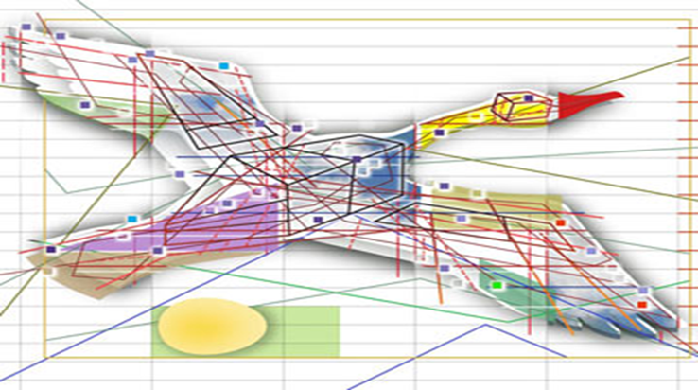
Data Mining
If you torture the data long enough, nature will confess.
--Ronald Coase
This is a sad and decidedly unscientific state of affairs we find ourselves in. Hardly anyone takes data analyses seriously. Or perhaps more accurately, hardly anyone takes anyone else's data analyses seriously. Like elaborately plumed birds who have long since lost the ability to procreate but not the desire, we preen and strut and display our t-values.
--Edward Leamer (1983, p. 37)

Slide 43

“Classic” data mining or p-hacking
The terminology “data mining” is often used in the context of pre-test bias. In particular, researchers often run a large number of different regressions on a body of data looking for significant t statistics (at ,say, the 5% level). Using this approach invalidates traditional hypothesis-testing procedures because such data mining is likely by chance to uncover significant t statistics; i.e., the final results chosen are much more likely to embody Type I error than the claimed 5%.
--From Peter Kennedy’s Guide to Econometrics (4th edtion)

Slide 44
To be clear, data mining is not the same thing as doing robustness checks
Let’s consider three signs you may be data mining
1. You only report estimates of the following equation:
y_{it} = α + β₁X_{1it} + β₂X_{2it} +… β_{k}X_{kit} + ε_{it} .
However, estimating this equation produces very different results:
ln(y_{it})= α + β₁X_{1it} + β₂X_{2it} +… β_{k}X_{kit} + ε_{it} .

Slide 45
2. You only report estimates of the following equation:
y_{it} = α₀ + α₁Z_{it-1} + β₁X_{1it} + β₂X_{2it} +… β_{k}X_{kit} + ε_{it} .
However, estimating any of these equations produces very different
results:
y_{it} = α₀ + α₁Z_{it} + β₁X_{1it} + β₂X_{2it} +… β_{k}X_{kit} + ε_{it}
y_{it} = α₀ + α₁Z_{it-2} + β₁X_{1it} + β₂X_{2it} +… β_{k}X_{kit} + ε_{it}
y_{it} = α₀ + α₁Z_{it-1}+ α₂Z_{it-2} + β₁X_{1it} +β₂X_{2it} +… β_{k}X_{kit} + ε_{it}
y_{it} = α₀ + α₁Z_{it} + α₂Z_{it-1}+ α₃Z_{it-2} + β₁X_{1it} +β₂X_{2it} +… β_{k}X_{kit} + ε_{it} .

Slide 46
3. You only report estimates of the following equation for respondents
ages 12-15:
y_{it} = α₀ + α₁Z_{it-1} + β₁X_{1it} + β₂X_{2it} +… β_{k}X_{kit} + ε_{it} .
However, you get very different results if your sample includes
16-year-olds.
A few more behaviors that can be described as data mining:
Stop project because of null results
Decide against submitting to a journal
Modifying your original hypothesis to better match results

Slide 47
Sensitivity Analysis
Why do a sensitivity analysis?
Reassure the reader that you’re not p-hacking
Good empirical work is transparent and easily replicated
Provide a range of estimates
Unless one particular specification is preferred, readers will expect a range of estimates
Often, theory does not dictate specification
Facilitate comparison of your estimates to those reported by previous researchers
Sensitive to what?
Choice of controls
Period under examination
To weight or not to weight?
Solon, Gary, Steven J. Haider, and Jeffrey M. Wooldridge. 2015. “What Are We Weighting For?” JHR, 50(2): 301-316.
Unit-specific linear trends
TWFEs with staggered treatment
Etc.
The goal is to be thorough without getting bogged down. It is easy to get bogged down…

Slide 48
Falsification tests
Goal
The goal is to convince the reader that your estimate is causal
Describe the threat to identification
Describing a variable as “potentially endogenous” is not enough
Describing the threat to identification sets up the falsification test or alternative ID strategy
Be specific!

Slide 49
Falsification tests from Anderson et al. (2021) J of Urban Economics
Anderson et al. (2021) estimate a large and precisely measured β₁
What might be some threats to identification? Name the omitted variables!
Maybe CAP laws were passed alongside other gun-related policies
Maybe CAP laws were passed alongside other policies designed to curb general violence among youths
Based on these two potential omitted variables, what might be some outcomes we could consider as falsification tests?

Slide 50
Bonus slides (added this morning!)
When it comes to structing the results section of your paper, you probably should not try to reinvent the wheel.
Descriptive figures/tables
Main results
Extensions
Robustness/sensitivity checks
Heterogeneity analyses
Analyses of supplemental data sets
Etc.
A working paper I just came across…
5 pages later…
2 pages after that…
Main estimates were shown in Table 4 and Figure 10 of the paper

Slide 51
Bonus slides (added this morning!)
A reminder to proofread before you submit to a journal!!!
This showed up about four or five times in the paper…

Slide 52
Short break

Slide 53
Section 2. Practical tips for writing your applied paper:
How to write an effective conclusion

Slide 54
The Conclusion
Repeat yourself, but don’t repeat yourself!
Conclusion contains much of what is in the intro, but should be shorter
(i) Open with a general motivation
Use new eye-catching stats to start conclusion
Consider Anderson and Sabia (2018, J of Law and Economics) on safe-storage gun laws and school shootings in the U.S.:
Start of introduction: “School shootings, such as the recent high-profile events in Chardon, Ohio; …and Santa Fe, Texas are usually committed by students under the age of 18. In fact, between 2012 and 2015, approximately 70 percent of shootings in K-12 schools in the United States were committed by minors.”
Start of conclusion: “The National Poll on Children’s Health recently indicated that 1 in 4 parents are ‘very concerned’ about school violence for their children. These fears are perhaps driven by the fact that school shootings have been reported at nearly a weekly rate since 2012.”
(ii) Reiterate specific motivation for scholars working in this area.
Remind readers of your contribution
(iii) Describe setting, data, and identification strategy
Briefer than intro
(vi) Results discussion.
The one place where I will go into more detail than in the introduction
Feel free to remind the reader of interesting sub-analyses
Heterogeneous effects
Particularly convincing robustness checks
Supplementary data analyses
Etc.

Slide 55
The Conclusion
The last paragraph of the conclusion is really important. Finish with a bang!
One of the more difficult paragraphs to write in a paper. It can feel daunting, but you have options…
(i) Opine about future research
(ii) Highlight a contribution not in your introduction
Historical U.S. studies that relate estimates to developing countries today
“Infant Health and Later-Life Labor Market Outcomes,” Lazuka (2018, J of Human Resources)
Milk inspections paper cited earlier (Anderson et al. 2022, NBER WP No. 30063)
(iii) Policy relevance
“The Impact of Mass Shootings on Gun Policy,” Luca et al. (2020, J of Public Economics)
“Accidents Will Happen? Unintentional Childhood Injuries and the Effects of Child Care Regulations,” Currie and Hotz (2004, J of Health Economics)
(iv) List caveats
Not as big a fan of this. I like including caveats in the conclusion, but maybe not as your final word.
This paper pulls it off:
“Is Legal Pot Crippling Mexican Drug Trafficking Organisations? The Effect of Medical Marijuana Laws on U.S. Crime,” Gavrilova et al. (2017, Economic Journal)
Or some combination of (i)-(iv)

Slide 56
The Conclusion
How long should it be?
Shorter than your introduction.
Data on my last 15 full-length papers for economics journals (size 12 font, double-spaced):
1-2 pages | 2-3 pages | 3+ pages
12 papers | 3 papers | 0 papers

Slide 57
Short break/Q&A

